Slide 1
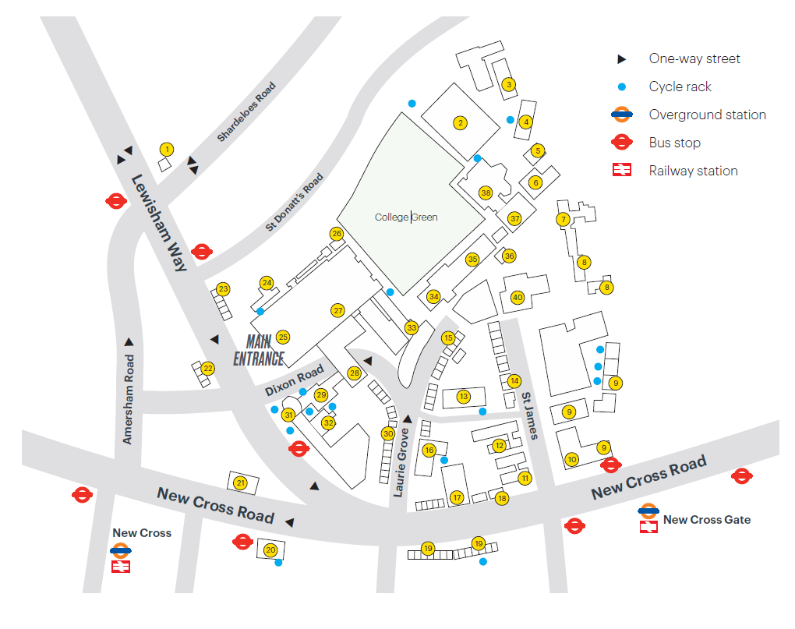
Goldsmiths Map App
Ian Gulland Lecture Theatre
Notes:
30 seconds

Slide 2
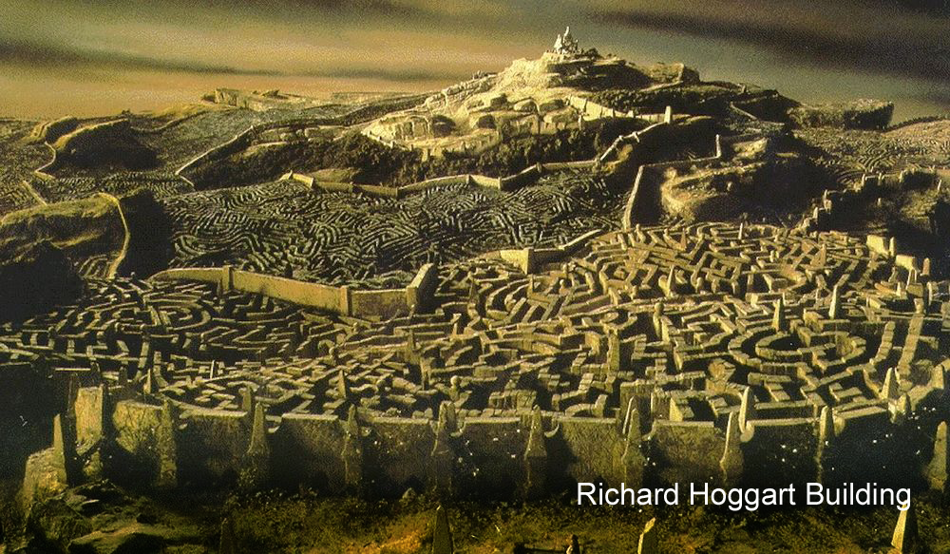
Notes:
The Motivation

Slide 3
Our Pathway
We started by Identifying the issue by asking students around the university about their issues and difficulties.
Further research was done to figure out an initial design and the necessary features
We decided to go with an application that would help students find their way around the university without having to use Wi-Fi on move
Notes:
1 minute

Slide 4



Features
Intended for offline use
Accessible interface
Adding features with others in mind
Easy Use of the programm
Notes:
1 minute

Slide 5





Current Developments
Operating system has been chosen
Map sourced and nodding process started
Secondary research completed on algorithms
Demo created
Github
Notes:
1 minute

Slide 6
Evaluation of the software Original requirements
Software to be accessible on most devices and easy to use
Map sourced from university
Offline access to be available alongside online
Elevators to be marked to help students
Aspire to include support and log in (students and staff) for software
Notes:
1 minute

Slide 7
Future Plans
To extract the data from the node maps efficiently
Additional Research to find suitable data structures
Redesign the aesthetics based on user feedback
Implementing a working version for android
Get the software to be approved and used by the university as their official map

Slide 8


